Slide 1
Antenna Simulation: Cross-Yagi
Pranav Munukutla

Slide 2
Simulation and its importance
Allows you to understand how antenna signals react to its surroundings before making it physically.
Helps to understand how much radiation is emitted to approve it for safe use by people.
The software we are using is Ansys HFSS(High frequency structure simulator)

Slide 3
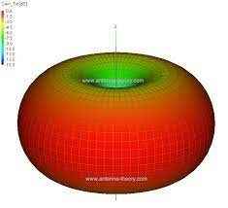
Basic Antenna Theory
The sole functionality of an antenna is power radiation or reception.
The radiation pattern is a plot that tells us how well the antenna transmits and receives in each direction.
The fields around an antenna are divided into 3 mains regions :
1. Reactive Near Field
2. Radiating Near Field or Fresnel Region
3. Far Field or Fraunhofer Region

Slide 4
Antenna Theory continued..
Directivity
Isotropic antenna
Omni-directionality
Antenna gain

Slide 5
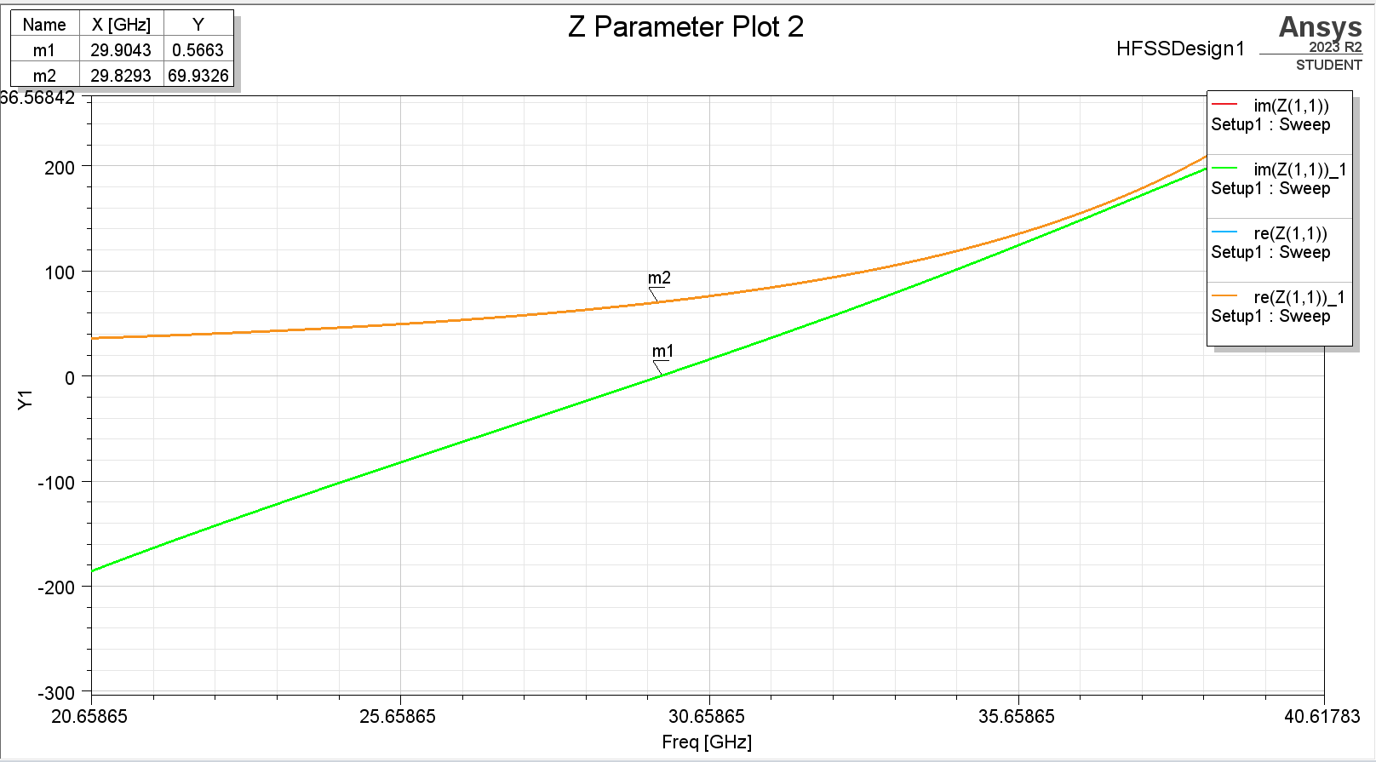
Antenna Theory continued..
Impedance of an antenna – relates voltage and current.
Impedance matching
VSWR (Voltage Standing Wave Ratio) is a parameter that tells us about impedance matching. The higher the impedance mismatch, higher the value of VSWR.

Slide 6
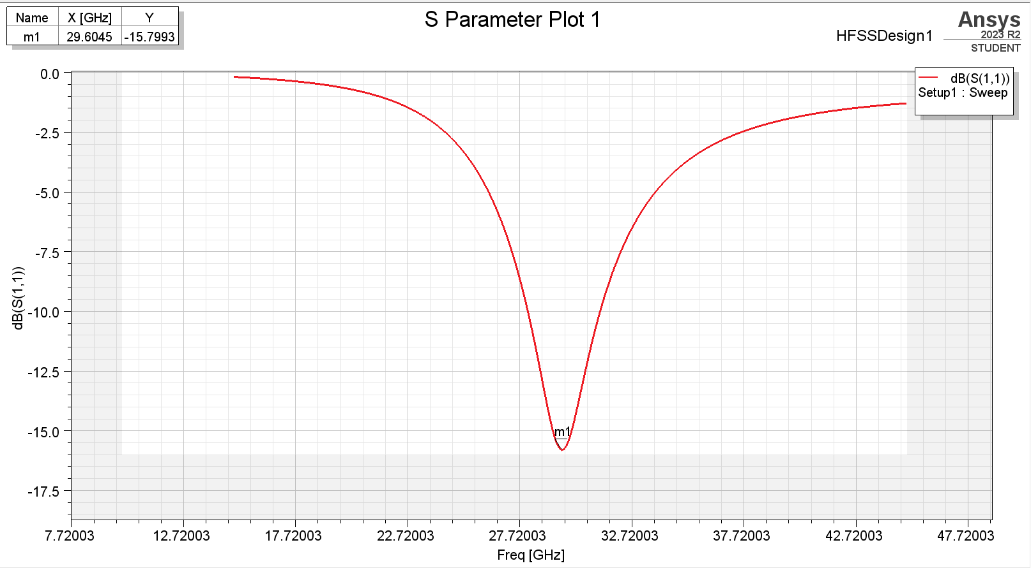
Antenna Theory continued..
SNM represents the power transferred from Port M to Port N in a multi-port network.
S11
S11 vs frequency
The polarization of an antenna

Slide 7
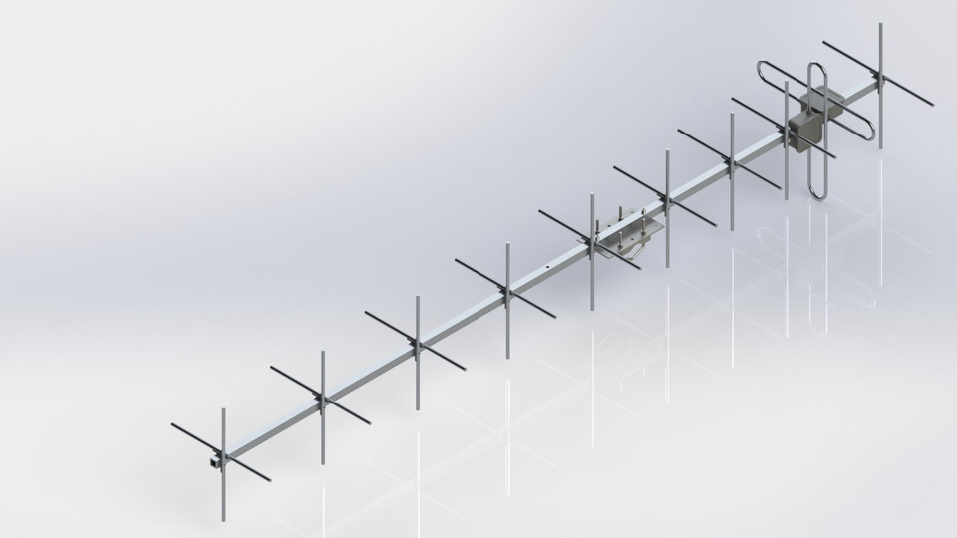
Cross-Yagi Antenna
Simple to construct
High gain
3 MHz - 3 GHz
Small bandwidth.
Elements
Circularly Polarized

Slide 8
Work Update So far and future Plan
Work done so far :
Understood all basic terms and parameters related to antennas.
Downloaded and got familiarised with the Ansys HFSS software.
Simulated a dipole antenna and a coaxial cable on the software.
Started with the simulation of a yagi-uda antenna
Future Plan:
Convert the yagi-uda antenna into a cross-yagi antenna and find the important results such as radiation patterns and S11 vs frequency plots.
Thank You!

